Slide 1

Revenue analytics from streaming services
Note - the numbers are small because I get very little money from streaming, so on many charts the numbers are less than one.

Slide 2
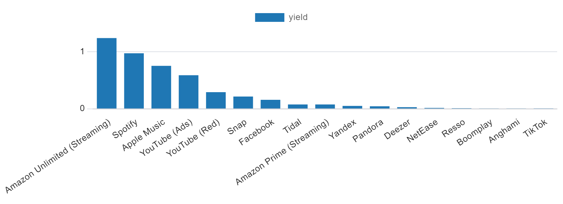
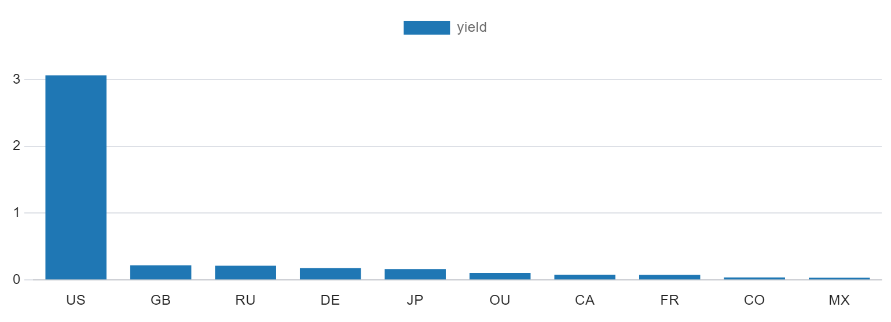
Examples of aggregation in SQL
Streaming services from which I get the most income
Countries from which I receive the most income

Slide 3
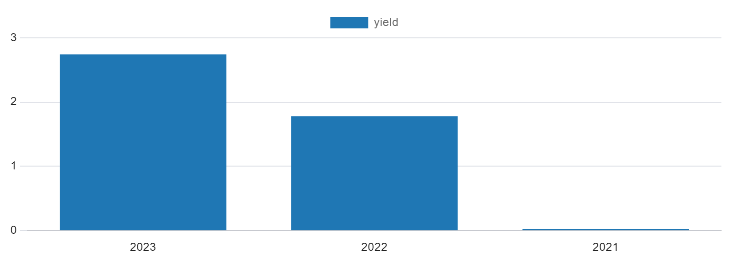
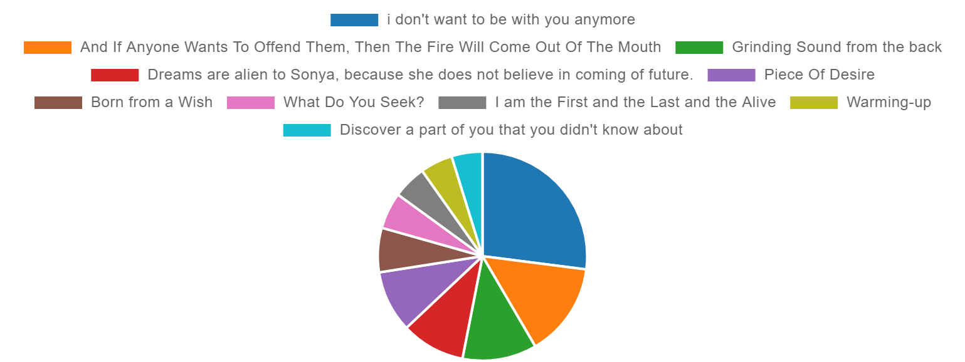
Examples of aggregation in SQL
Revenue growth by year
Top 10 most popular songs

Slide 4
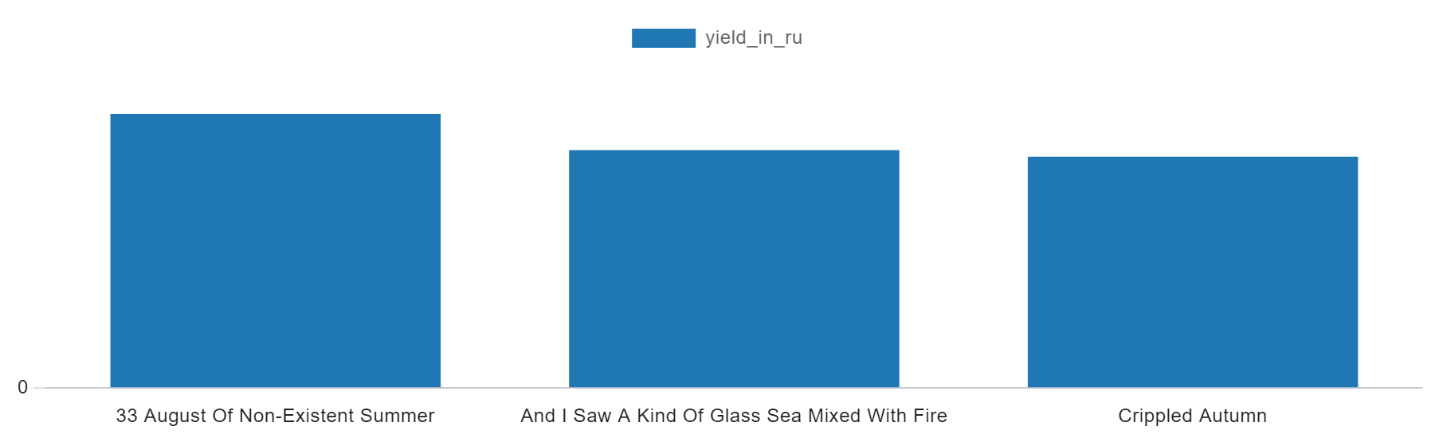
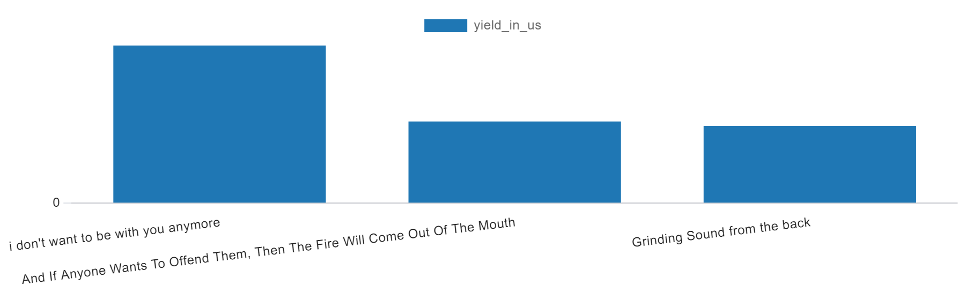
Examples of aggregation in SQL
Top 3 most popular songs in the Russian Federation
Top 3 most popular songs in the US

Slide 5
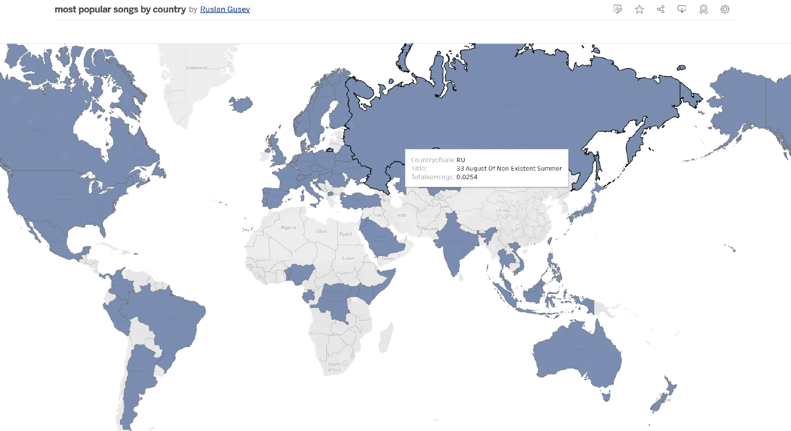
Visualization in Tableu
the most popular song in each country
https://public.tableau.com/shared/Z5GW2R535?:display_count=n&:origin=viz_share_link

Slide 6
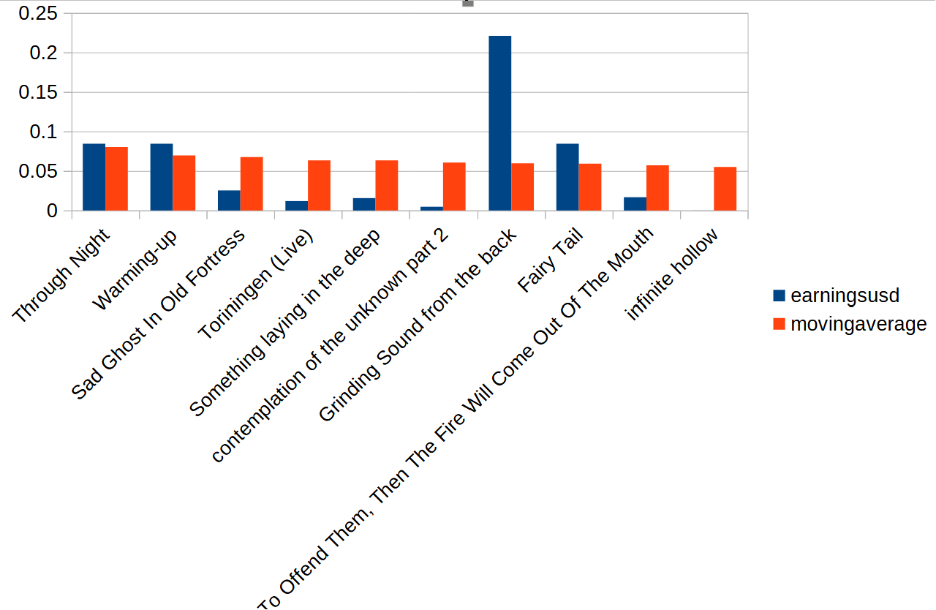
Visualization in excel
moving average

Slide 7
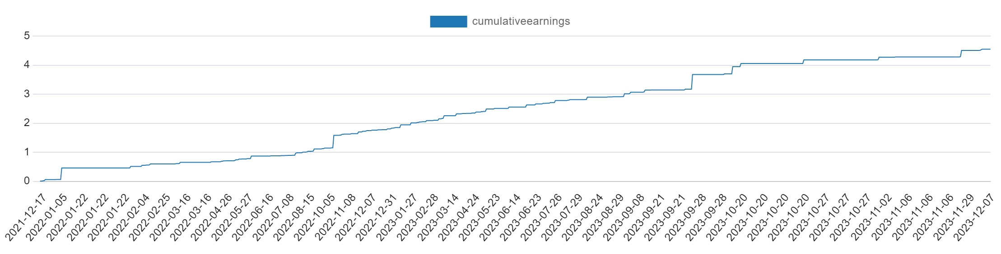
Cumulative income

Slide 8
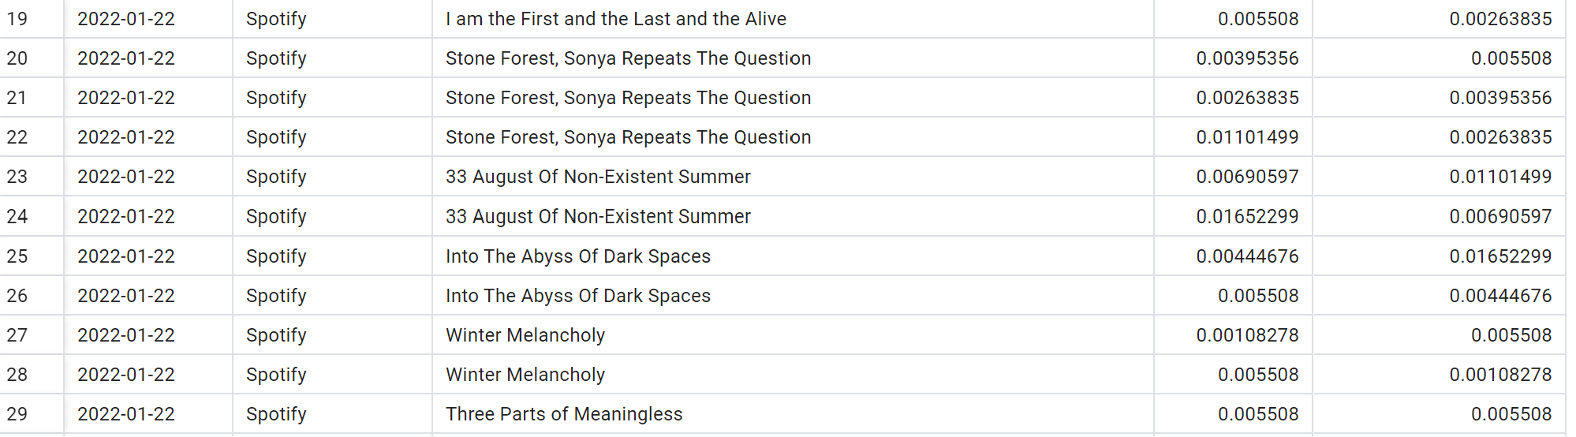
Comparison of revenues from the current reporting period with the past one in a particular store

Slide 9
Thank you for your attention!
date: 12-09-2023

